Slide 1
M. Tech (CSE) – Second Semester (Term: July-Oct 2022) Non-CIE Component Quantum Computing (MCS22) Open Quantum Systems
Department of Computer Science and Engineering
Presented By:
Deeptashree D

Slide 2
Open Quantum Systems
An open quantum system is a quantum-mechanical system that interacts with an external quantum system, which is known as the environment or a bath.
These interactions significantly change the dynamics of the system and result in quantum dissipation, such that the information contained in the system is lost to its environment.
It is important to develop a theoretical framework for treating these interactions in order to obtain an accurate understanding of quantum systems.
Techniques developed in the context of open quantum systems have proven powerful in fields such as quantum optics, quantum statistical mechanics, quantum information science, quantum thermodynamics, quantum biology.

Slide 3
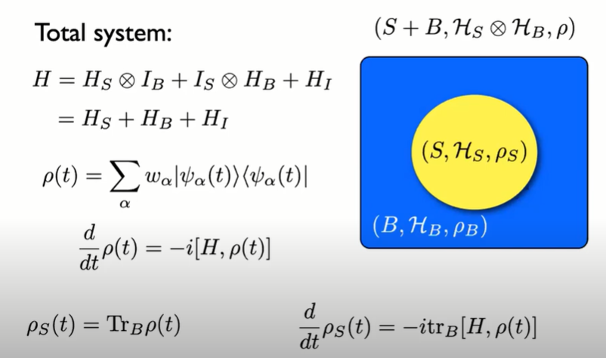
Open Quantum System

Slide 4
Quantum system and environment
Requires the inclusion of its environment, which results in a new system that can only be completely described if its environment is included and so on.
The eventual outcome of this process of embedding is the state of the whole universe described by a wave function
Even if the combined system is in a pure state and can be described by a wavefunction , a subsystem in general cannot be described by a wavefunction.
This observation motivated the formalism of density matrices, or density operators, introduced by John von Neumann in 1927and independently, but less systematically by Lev Landau in 1927 and Felix Bloch in 1946.

Slide 5
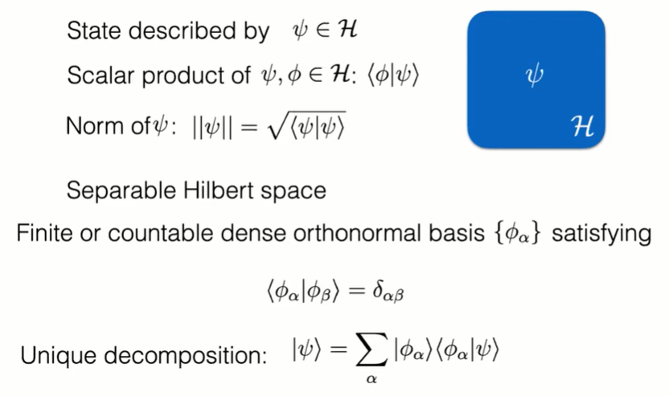
Closed Systems

Slide 6
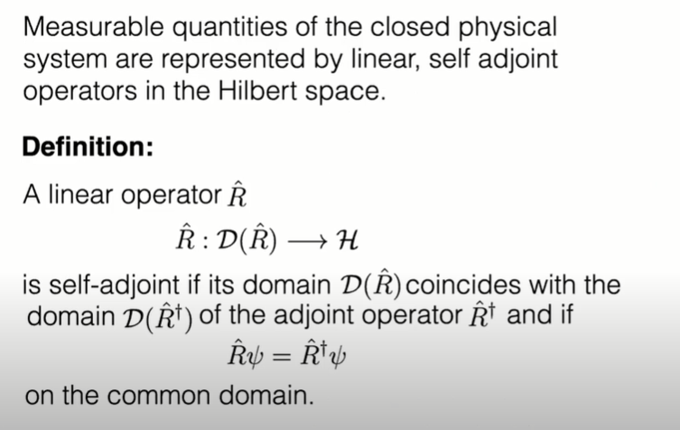
Observables

Slide 7
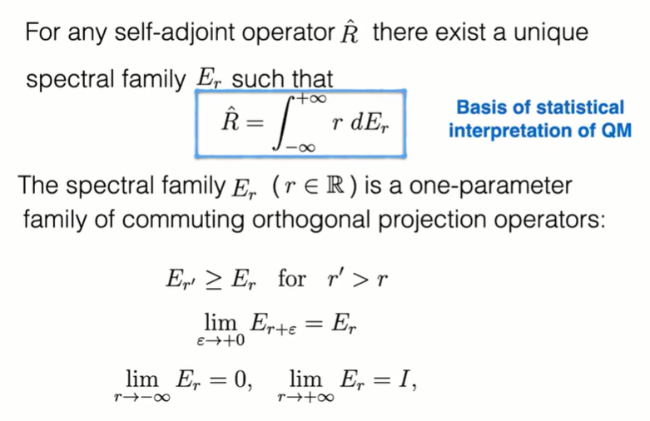
Spectral Theorem

Slide 8
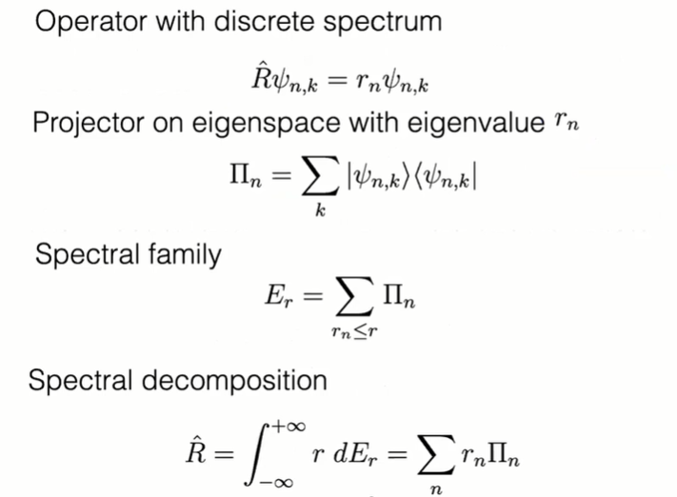
Example

Slide 9
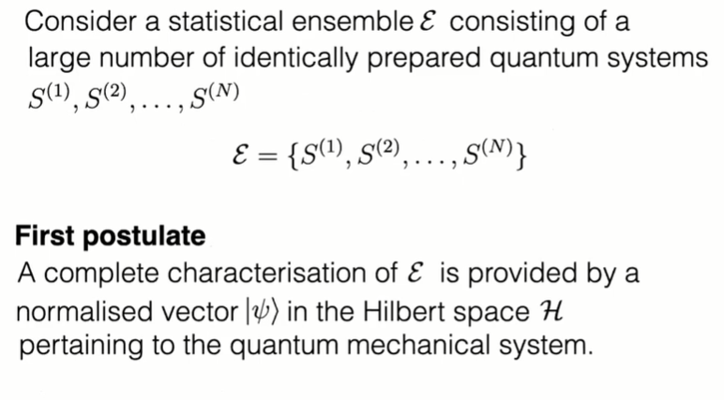
Observables and Random Variables

Slide 10
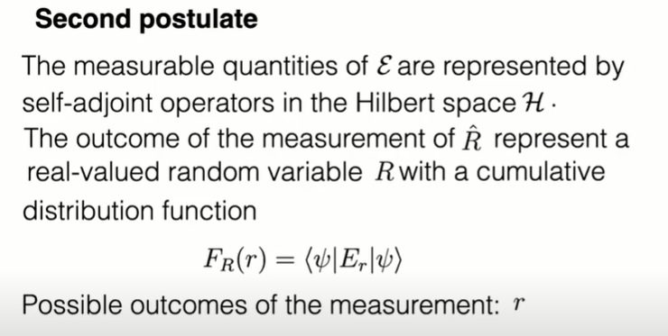
Observables and Random Variables (2)

Slide 11
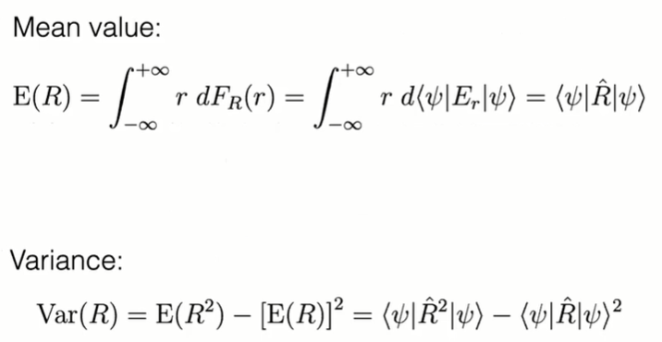
Observables and Random Variables (3)

Slide 12
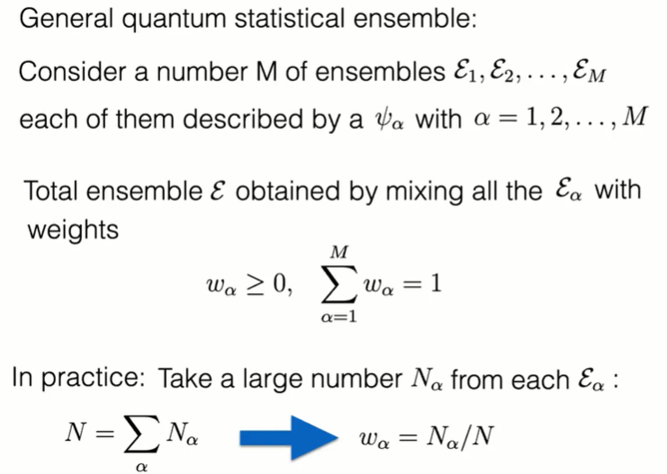
Pure States and Statistical Mixtures

Slide 13
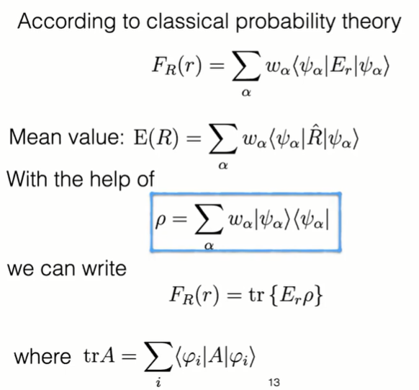
Statistical formulae of QM

Slide 14
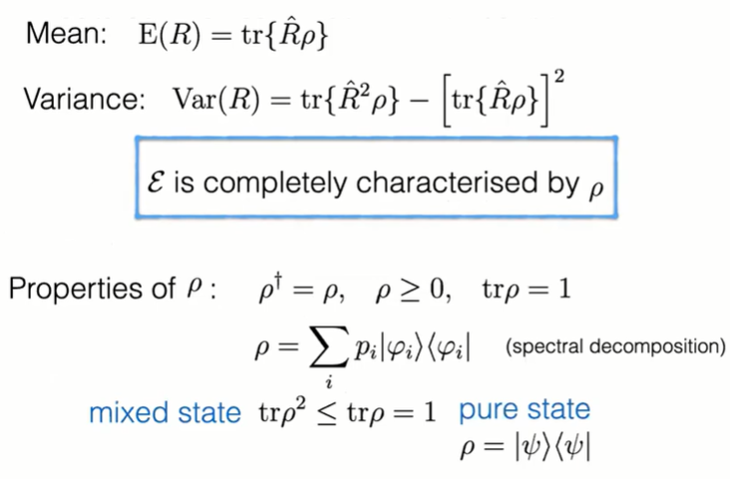
Statistical formulae of QM (2)

Slide 15
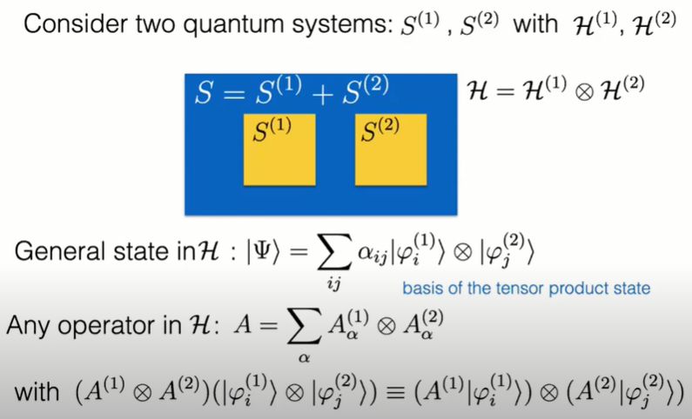
Composite Systems

Slide 16
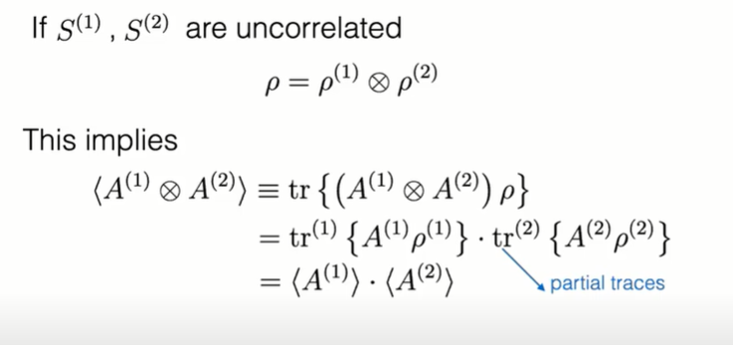
Density Matrix of Composite Systems

Slide 17
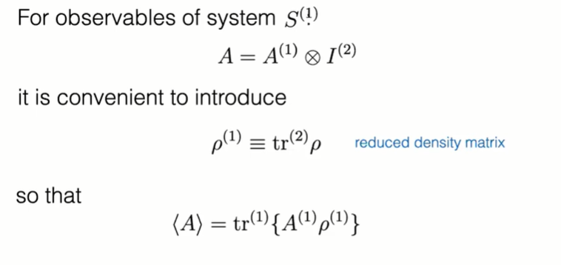
Reduced Density Matrix

Slide 18
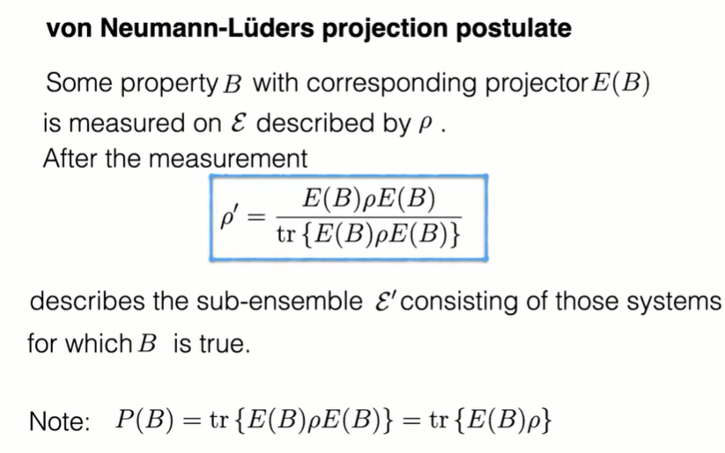
Ideal Quantum Measurement

Slide 19
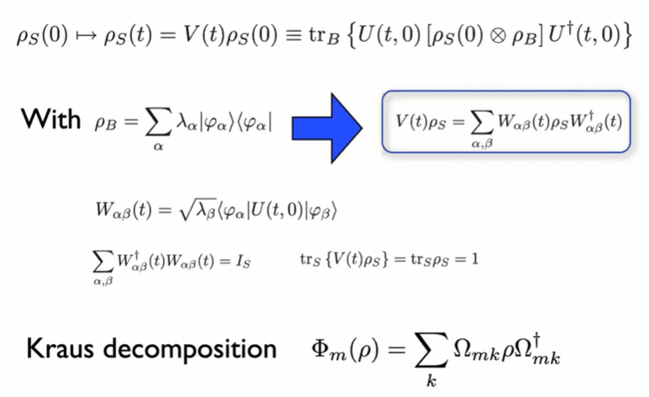
Dynamical Maps

Slide 20
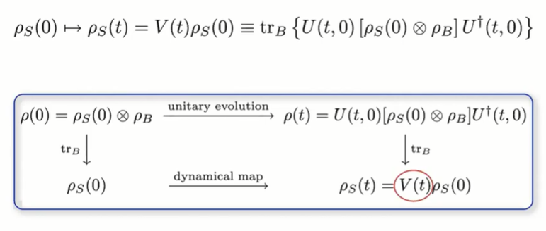
Dynamical Maps

Slide 21
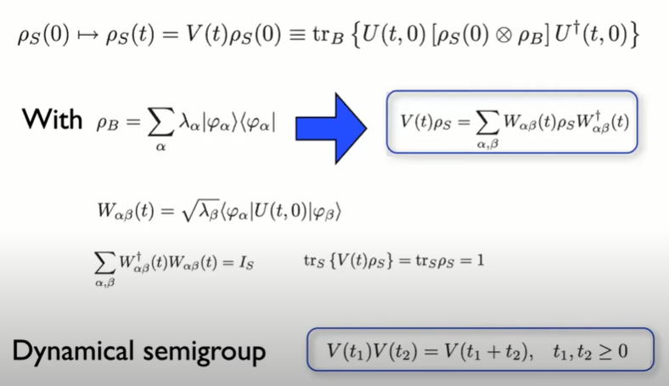
Dynamical Maps

Slide 22
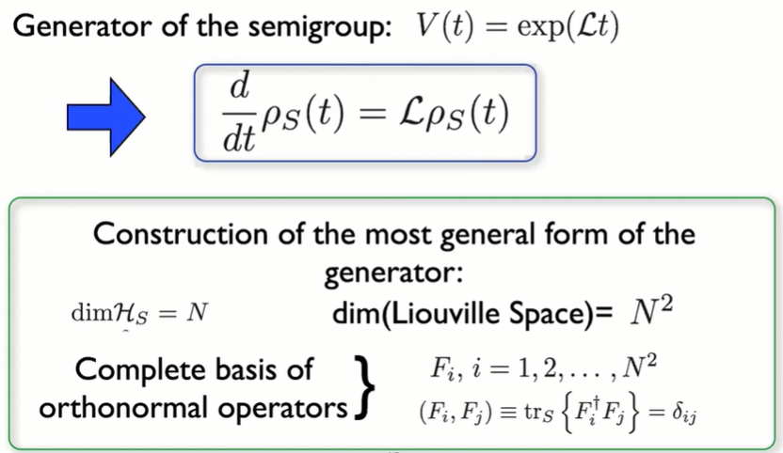
Markovian Quantum Master Equation

Slide 23
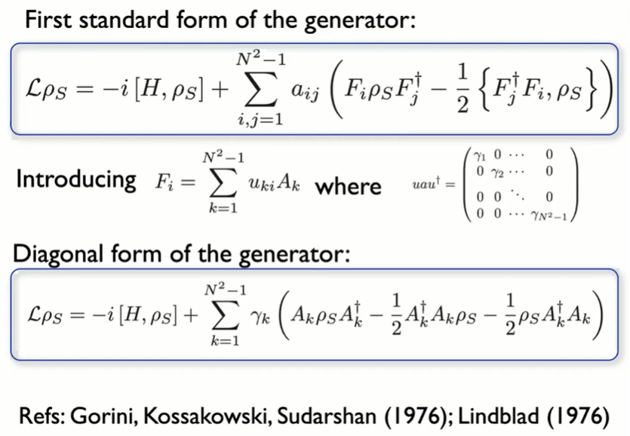

Slide 24
THANK YOU

